Slide 1
UNDERSTANDING CAREER ASPIRATIONS
Internship project on
Presenting by L. L. Sree Harshitha

Slide 2
ROAD MAP OF PROJECT
1
3
5
7
Dashboards
- - - - - - - -
Developed three dashboards on customer service, finance and orders in EXCEL
Data Collection
- - - - - - - - - - -
Created a Google Form with tailored questions to collect data on Gen-Z's career aspirations.
Analyzing in SQL
- - - - - - - - - - -
Conducted data analysis using SQL, solving complex questions with the help of Common Table Expressions (CTEs) and joins.
Focused Excel Dashboard
- - - - - - - - - - -
Developed three focused dashboards for each area, incorporating KPIs, Pivot tables, measures, and groups in Excel.
2
4
6
Problem Statement
- - - - - - - - - - - -
Developed a problem statement to explore and educate about the career aspirations of Gen-Z, addressing challenges and personal insights.
Cleaning in SQL
- - - - - - - - - - - -
Loaded data dump into MySQL Workbench, cleaning and exploring high-level information using SQL basics.
General Excel Dashboard
- - - - - - - - - - -
Created a Excel dashboard summarizing Gen-Z's learning aspirations, mission aspirations, and manager aspirations.

Slide 3
Stage1 : PROBLEM STATEMENT
Organizations are facing challenges in keeping Gen-Z employees due to differing values and communication styles across generations. Older employees often struggle to connect with their younger counterparts, resulting in misunderstandings and diminished respect. Furthermore, Gen-Z is frequently labeled as difficult or unrealistic, which can obstruct their career advancement. Many entered the workforce during the pandemic, contributing to their sense of uncertainty. It is crucial for older generations to recognize and address the unique challenges that Gen-Z encounters in their professional lives.

Slide 4
Stage 2 :DATA COLLECTION

Slide 5
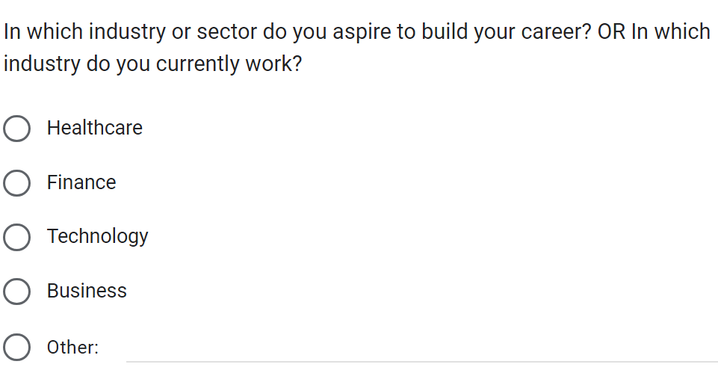
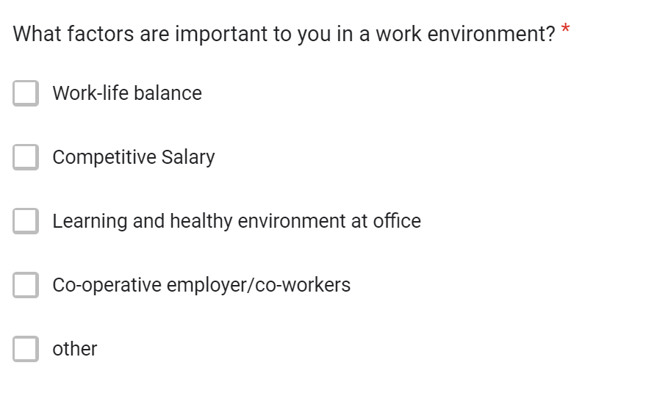
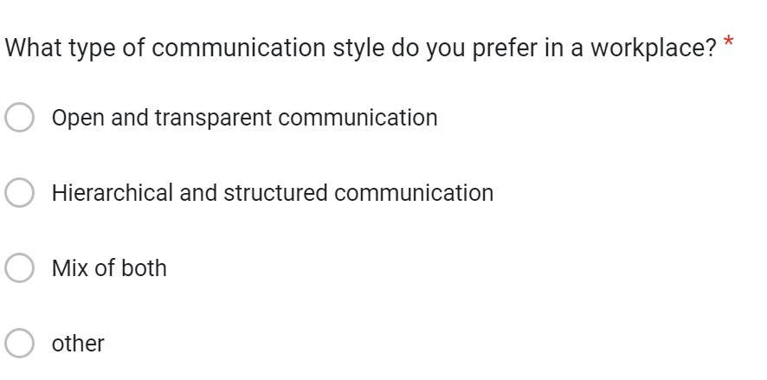

Slide 6

Stage 3 : Cleaning & Standardizing in SQL

Slide 7
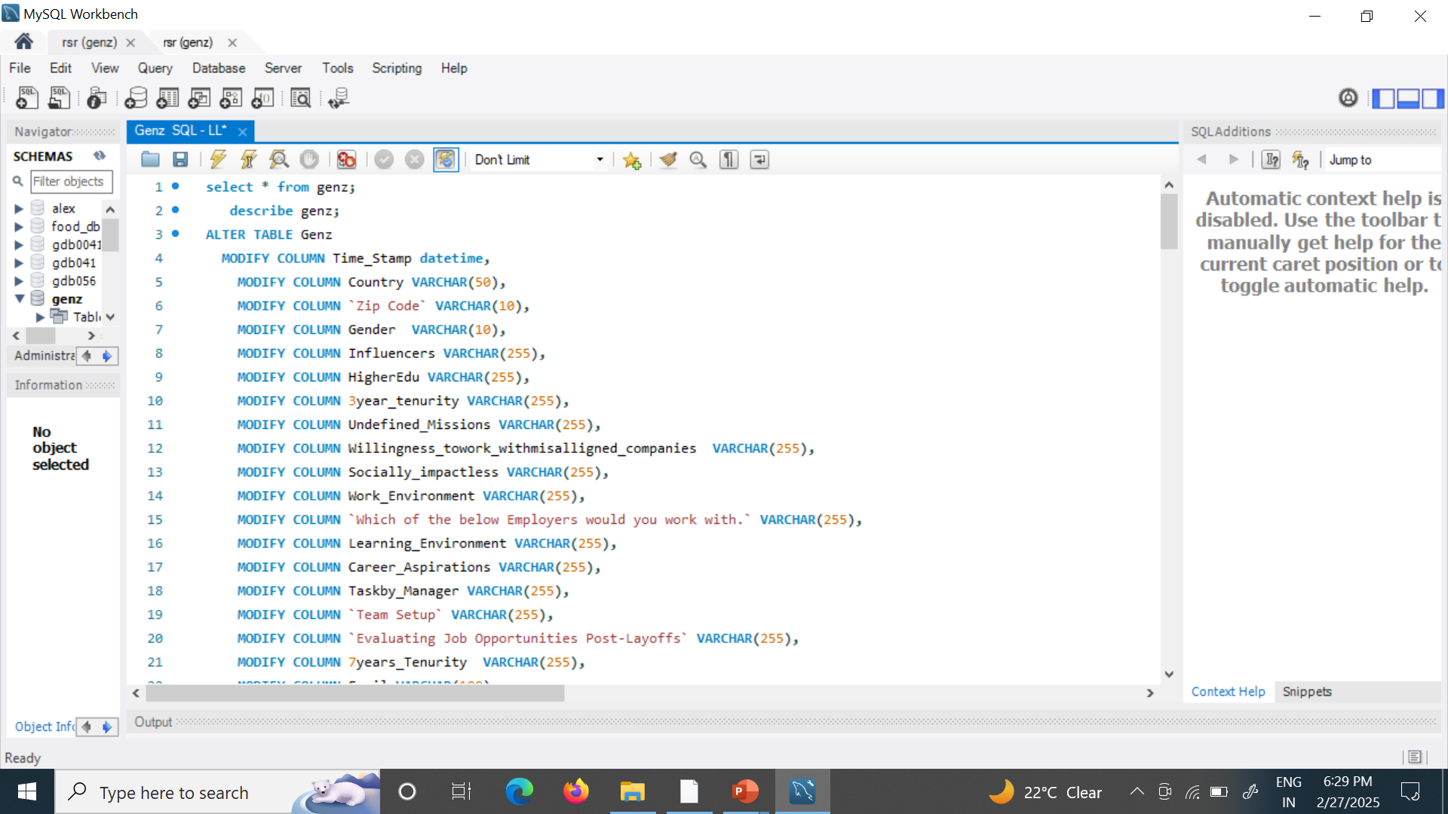
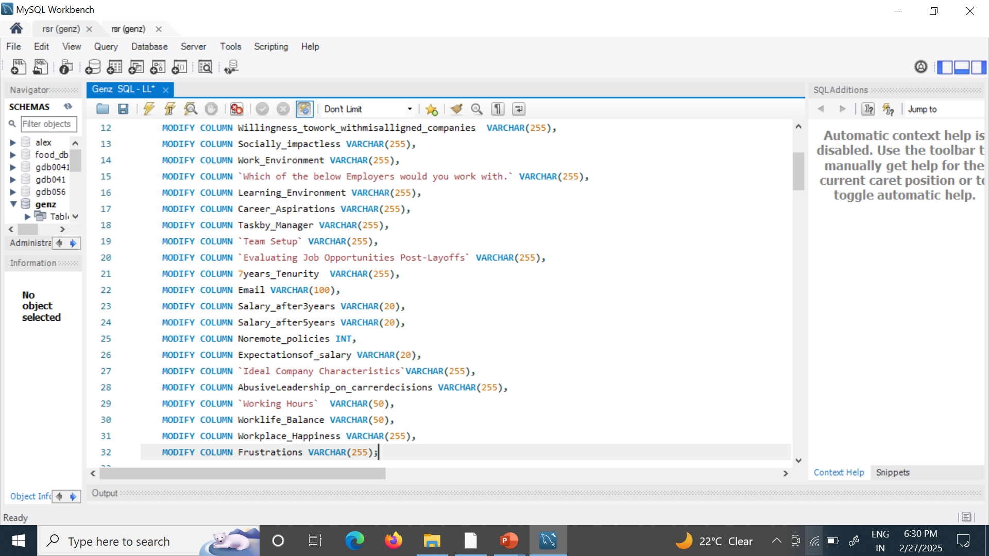

Slide 8

Stage 4 : Analyzing in SQL

Slide 9
Q1 : What is the gender distribution of respondents from India?
Q2 : What percentage of respondents from India are interested in education abroad and sponsorship?
Q3 : What are the 6 top influences on career aspirations for respondents in India?
Q4 : How do career aspiration influences vary by gender in India?
Q5 : What percentage of respondents are willing to work for a company for at least 3 years?
Q6 : How many respondents prefer to work for socially impactful companies?
Q7 : How does the preference for socially impactful companies vary by gender?
Q8 : What is the distribution of minimum expected salary in the first three years among respondents?
Q9 : What is the expected minimum monthly salary in hand?
Q10 : What percentage of respondents prefer remote working?
Q11 : What is the preferred number of daily work hours?
Q12 : What are the common work frustrations among respondents?
Q13 : How does the need for work-life balance interventions vary by gender?
Q14 : How many respondents are willing to work under an abusive manager?
Q15 : What is the distribution of minimum expected salary after five years?
Q16 : What are the remote working preferences by gender?
Q17 : What are the top work frustrations for each gender?
Q18 : What factors boost work happiness and productivity for respondents?
Q19 : What percentage of respondents need sponsorship for education abroad?

Slide 10
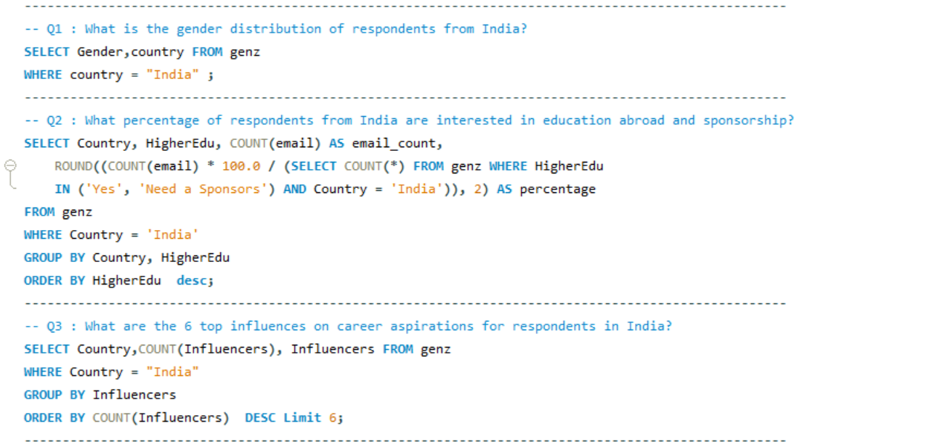
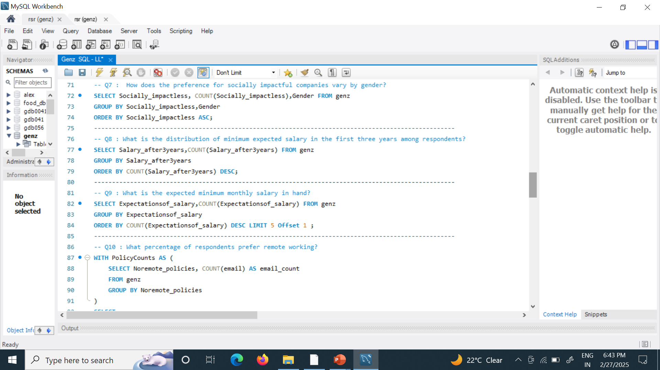
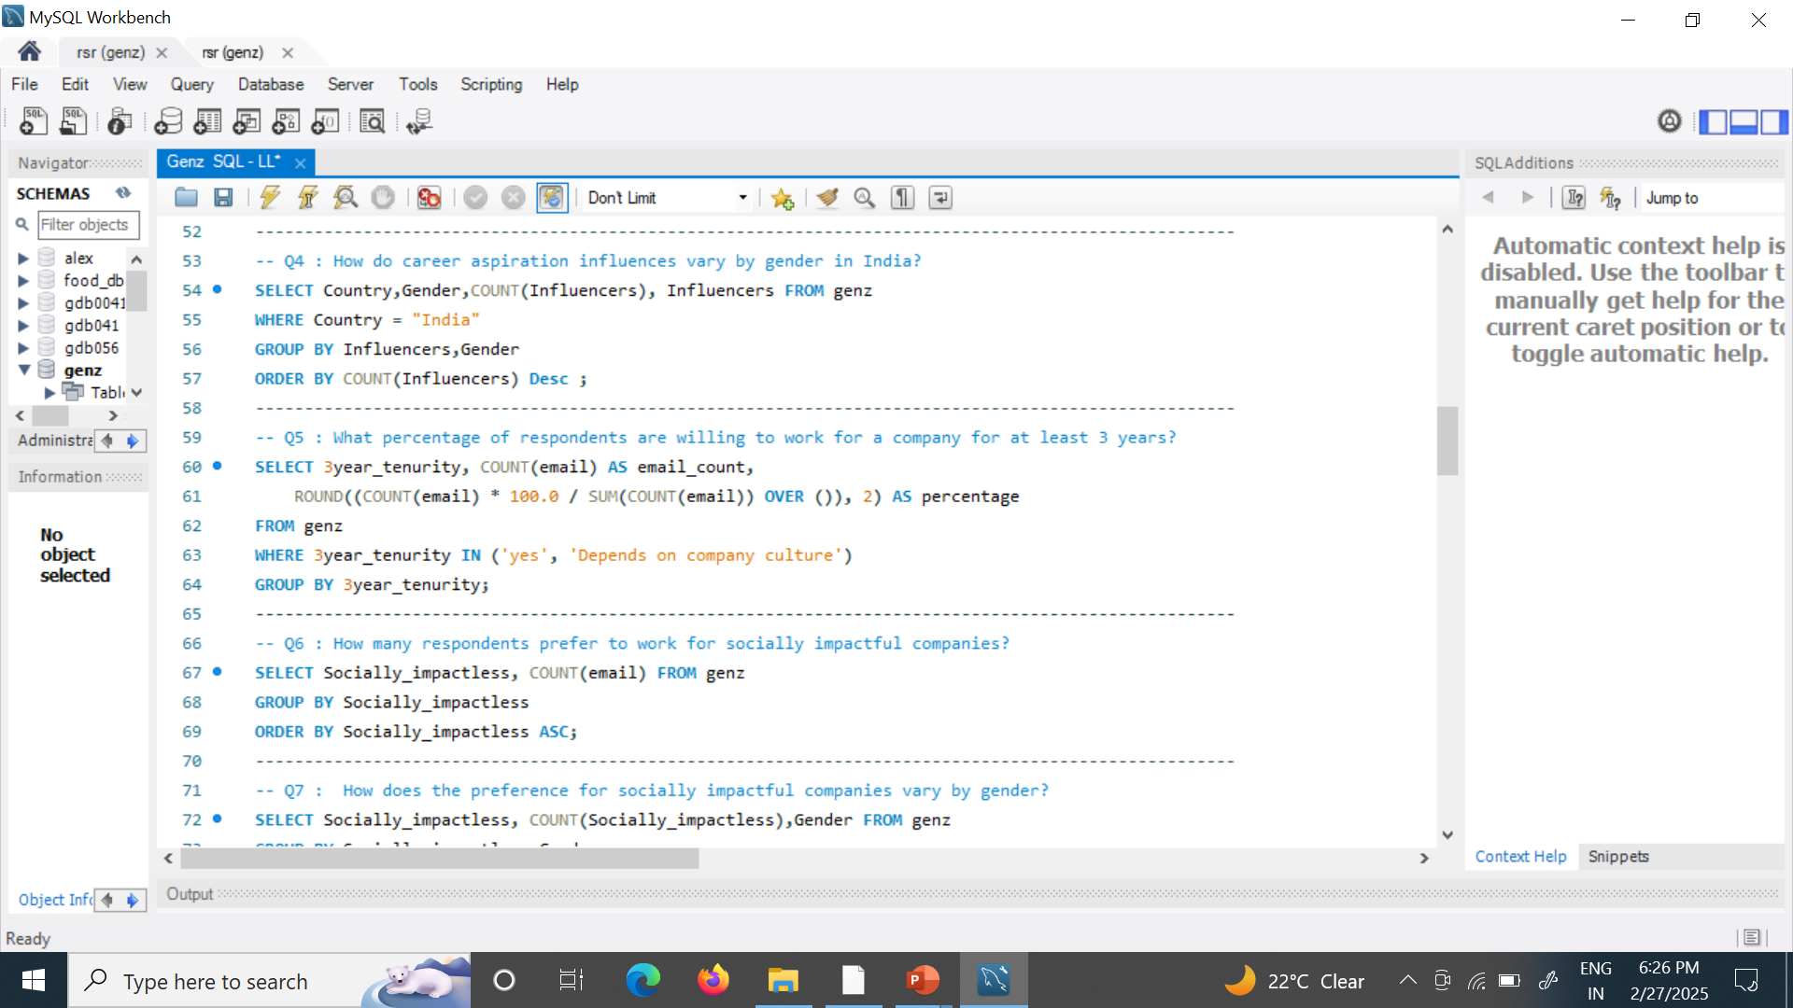
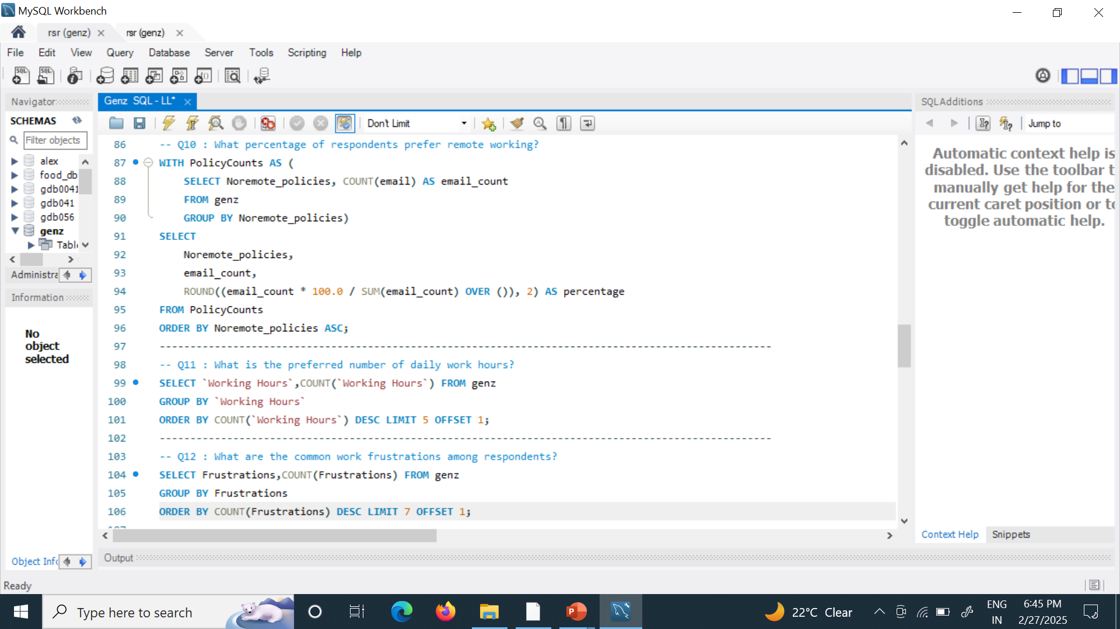

Slide 11
Stage 5 : GENERAL EXCEL DASHBOARD

Slide 12
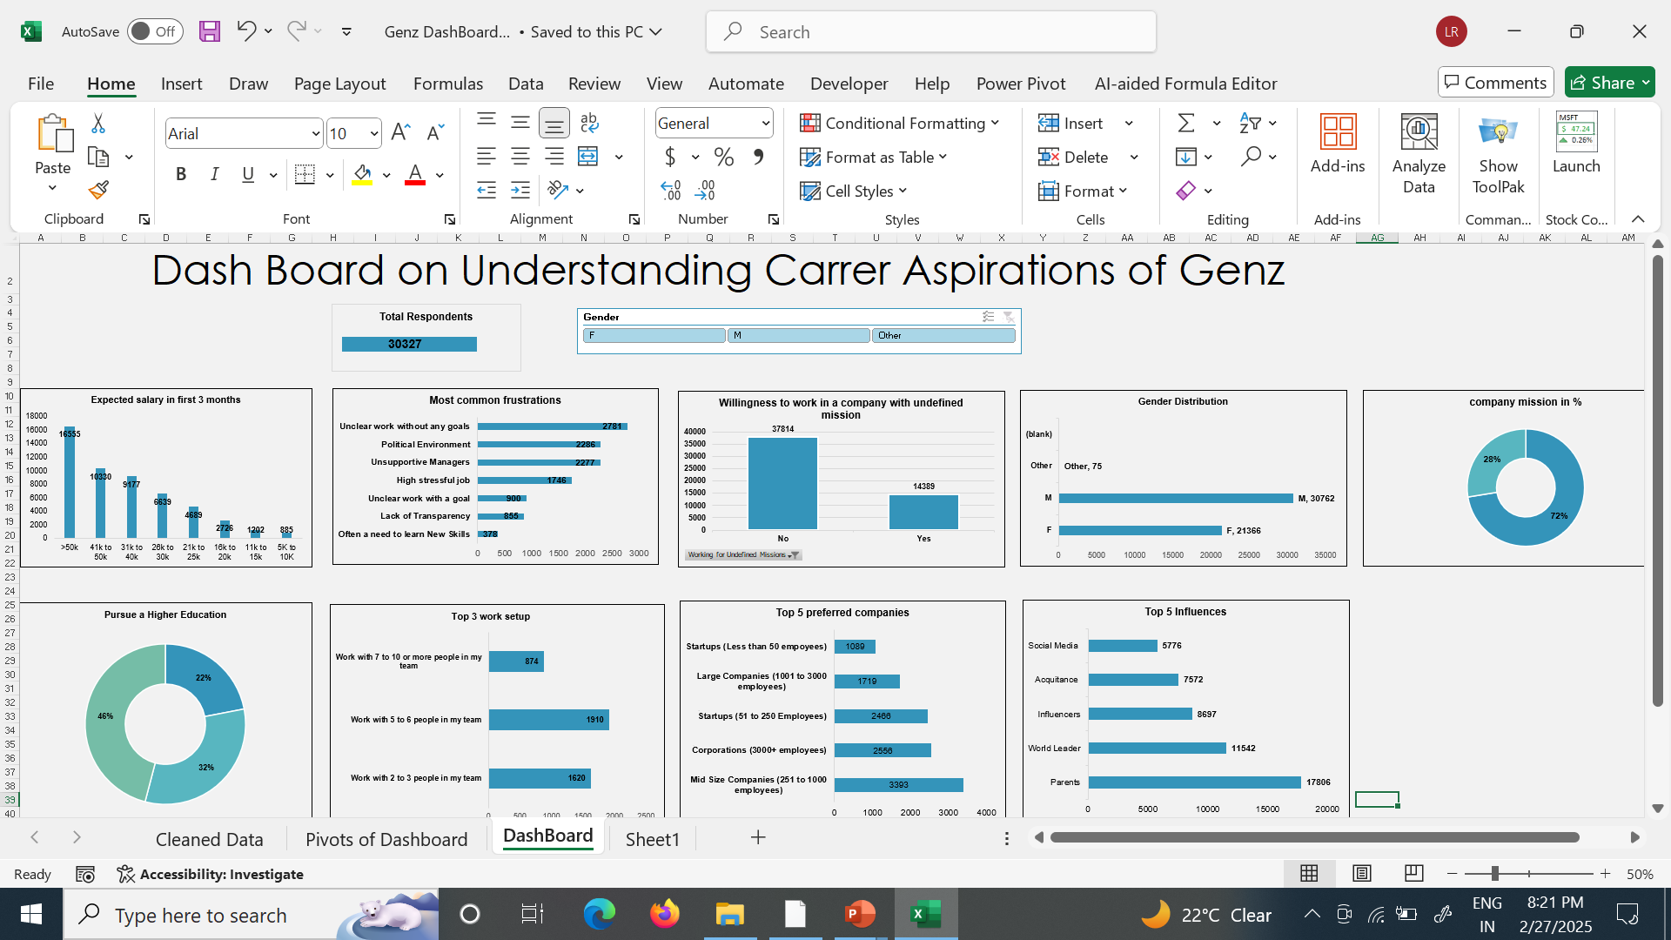

Slide 13

Stage 6 : Focus Area Driven on Excel dashboard

Slide 14
INTRODUCTION
Manager Aspirations
Mission Aspirations
Manager Aspirations
Aspirations
spirations
Exploring Managerial Dynamics :
Gender distribution , working hours , total respondents, salary expectations , related to working
and actions, type of learning , Preferential for socially impactful companies , clarity on company evaluation
Exploring Genz work trends:
Company mission Company mission and actions, type of learning , Preferential for socially impactful companies , clarity on company evaluation

Slide 15
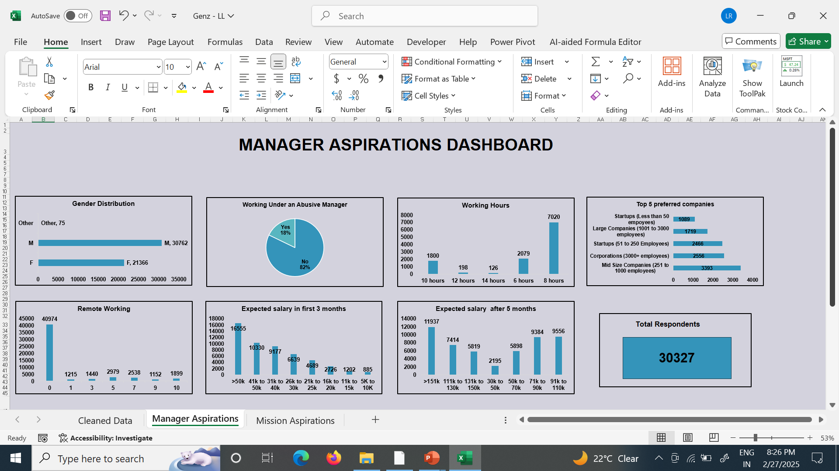

Slide 16
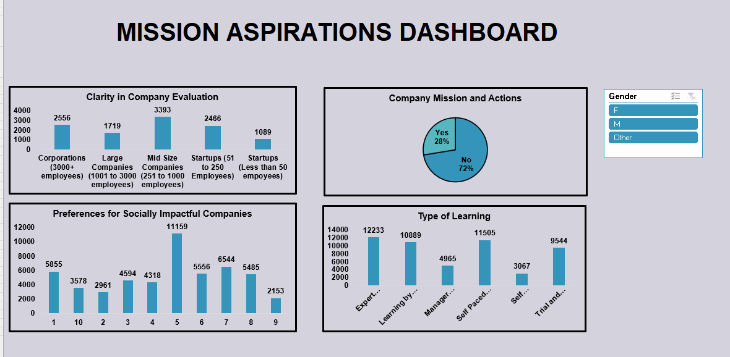

Slide 17
Problem:
Low Employee Satisfaction Scores
Problem:
Project Completion Times
Problem :
Poor or Low Salaries
Recommendations:
Conduct focus groups to gather detailed feedback.
Enhance communication through regular town hall meetings.
Increase recognition programs for employee achievements.
Recommendations:
Review project management practices to identify bottlenecks.
Implement agile methodologies to improve flexibility.
Allocate resources more effectively to meet deadlines.
Recommendations :
Conduct regular market research
Implement performance-based pay
Enhance non-monetary benefits such as health insurance, flexible work hours or professional development opportunities

Slide 18
Certificates issued by the kulturehire :
Data Analyst : ..\Certificate\certificate-data-analyst-internship-66da60bee9078828fd0868f6.pdf
SQL Certificate : ..\Certificate\certificate-mysql-for-beginners-2024-6640d9d0384e44681e0965d6.pdf
Excel Certificate : ..\Certificate\Kulture hire excel certificate.pdf

Slide 19
Thank you
L. L. Sree Harshitha

